Slide 1

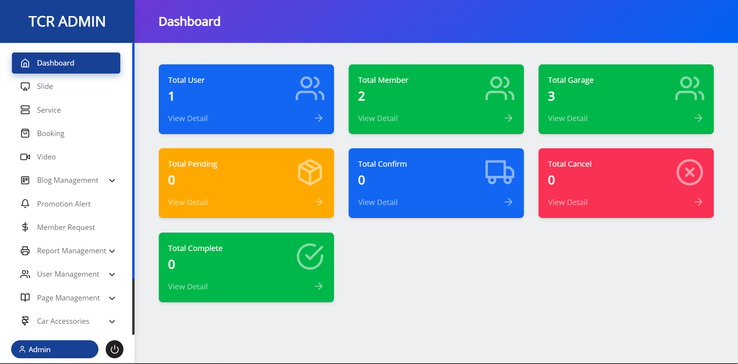

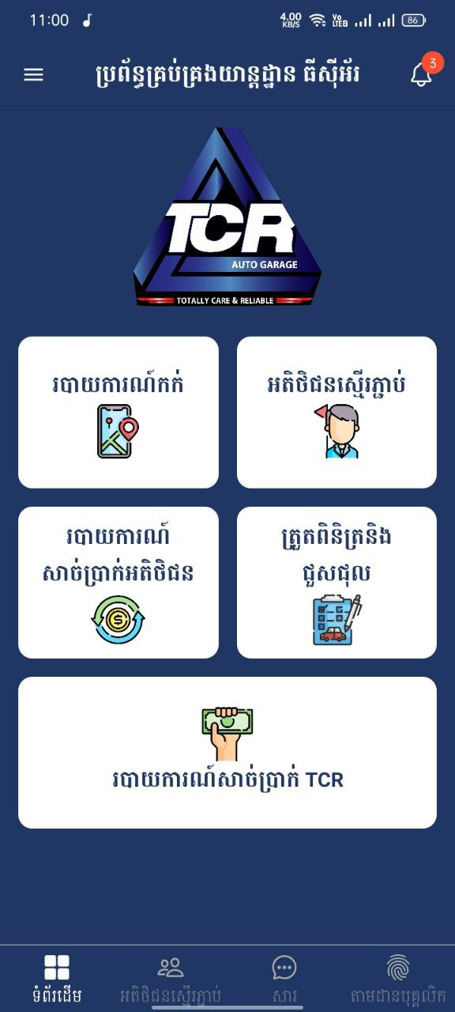
Garage Management
Garage Name
Easy to manage and solve all garage problem include customer issues
Garage logo

Slide 2
GROUP 9 CLASS E6
Mouern Puthsitha
Chim Pharath
kheng Youleang
Chea Seryleak

Slide 3
Introduction & Brief Background

Slide 4
Brief Background
Nowadays Car need Garage Service that provide the standard car , Being a car owner, you must know the feeling of your car, is it ok, or sick?
Therefore, Car Owner need to check their car health or take care, however if the car has broken or getting some issues, the place the match with : is the Garage Station (24/7 service),
Thus, to the garage is carefully with customer,
However, worker is still necessary for garage station, no matter the garage has or not have system, worker and customer is important

Slide 5
why did we choose this topic?

Slide 6
Garage Need System to Manage
Garages have to have systems to control whole garage .
Nowadays , many garage hasn’t have system to manage any function, to make garage better than before, I seen some problem when garage doesn’t have system, so we design system for garage, especially car garages,

Slide 7
Make New Generation of Garage Station
New Generation has to be replace traditional garage,
To solve all the problem of old system , new system of garage is necessary to implementation for garage admin and garage user.

Slide 8

Dare to do something new and hard
1
Just want to said that many programmer has set their goals, therefore their goals can’t get of the comfort zone of their knowledge, we thought whatever, we could, we could, no matter what is , keep griming

Slide 9
Work break-down structure

Slide 10

Request for Proposal
Meeting Client to know what is client business flow, and talk about proposal

Slide 11
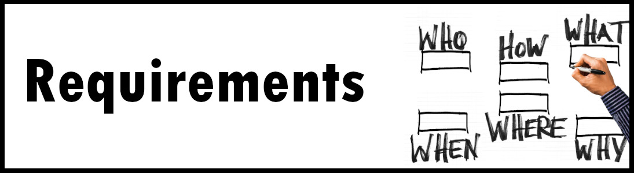
Requirements
We need the whole team to pay attention, to join as a competition, especially to find and know the requirement after meeting client

Slide 12
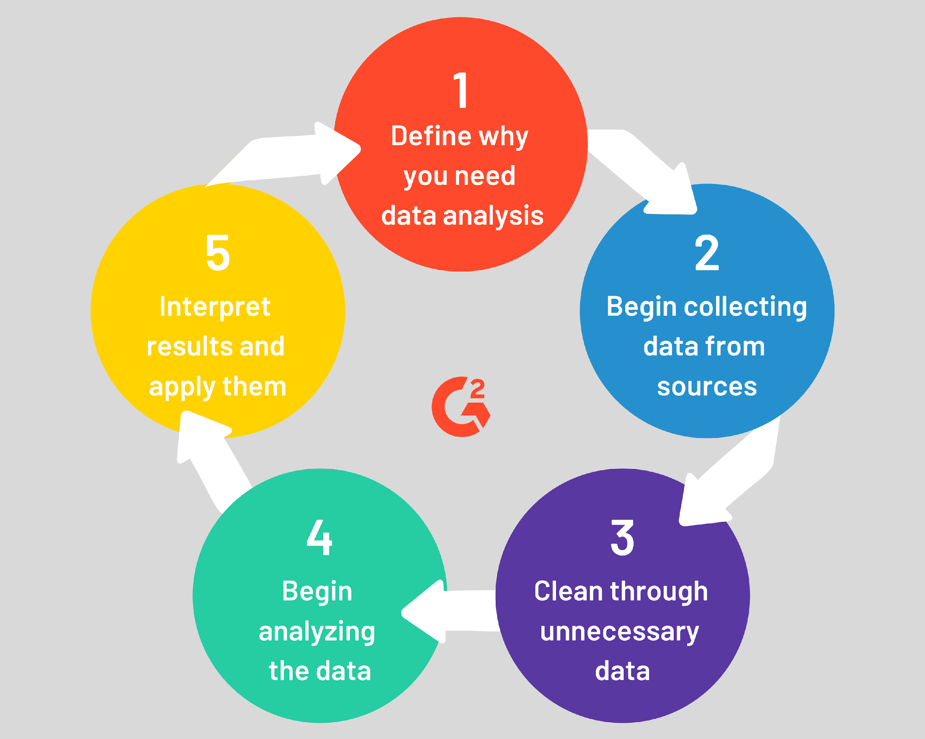
Analysis

Slide 13
Final Part
Design : Create DB, DBRS,
Coding : Mobile & Web
Testing : Mobile (user & admin) & Web(admin)
Maintenance :

Slide 14
how are we going to do it?

Slide 15
Timeline & Duration
Nov(2022)
Dec (2022)
Jan (2023)
Feb (2023)
March (2023)
April (2023)
May (2023)
Request for proposal
Requirement
Analysis
Design
Coding
Testing & release
Maintenance

Slide 16
Role & Position
Project Manager
Moeurn Puthsitha
Backend & API
Moeurn Puthsitha & Seryleak
UX UI & Frontend
Moeurn Puthsitha & Chim Pharath
Testing & Maintenance
Moeurn Puthsitha & Kheng Youleang

Slide 17
What system have and provide?

Slide 18
Production
2 Mobile Application ( user & admin)
2 Mobile Platform ( android & IOS )
Admin Website ( admin panel )
Promotion
Security App and Web
Silver Card Member

Slide 19
Functionality
Mobile Application
Website

Slide 20
1. Mobile Application
User App
Home Tap
User Profile
Page Management
3 languages (kh, en, ch)
Admin App
Home Tap
Admin Profile
Page Management
Notification
3 languages (kh, en, ch)

Slide 21
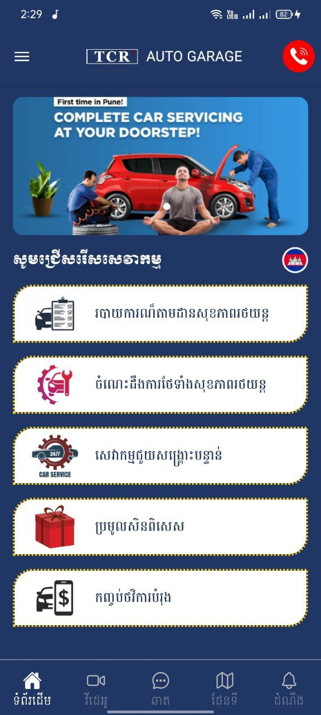
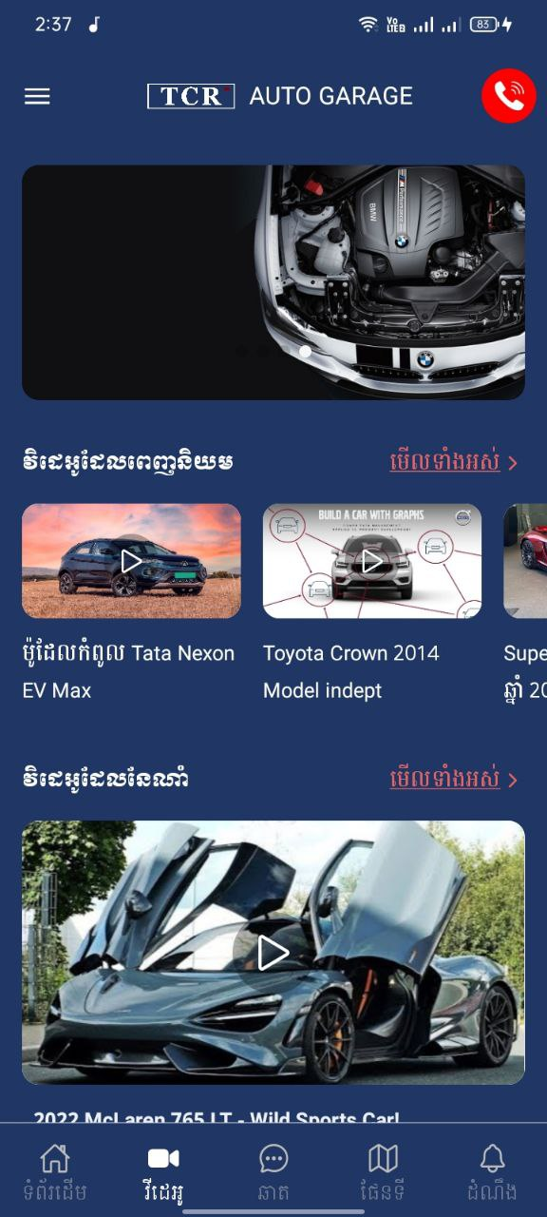

User App
Home Tap
Home Screen (slides show, list main services)
Video
Chat
Map
Notification

Slide 22
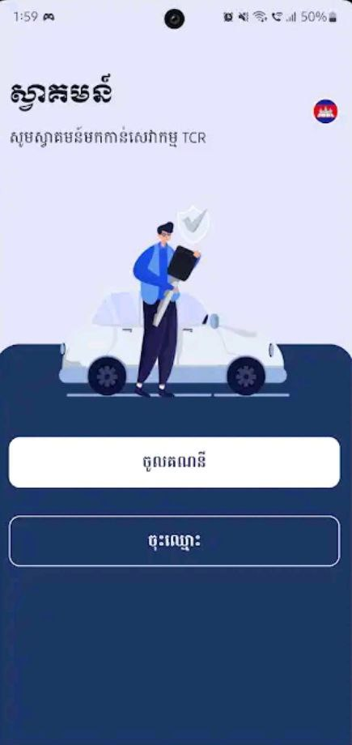
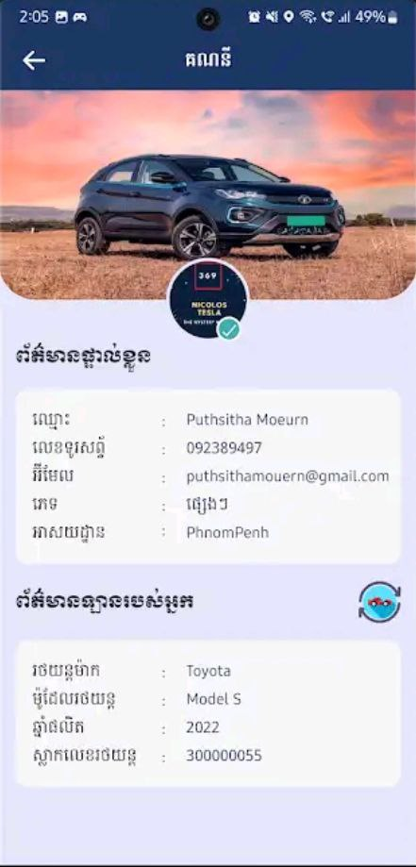
User App
User Profile & Authentication
Login , Register, forget pass, change, Edit Profile,
Profile Screen (switch car, add car, edit car)
Log out,
Verify Code (OTP, Gmail, …)
Car Status

Slide 23
User App
Page Management
About us
Privacy Policy
Term Condition
Contact Us

Slide 24

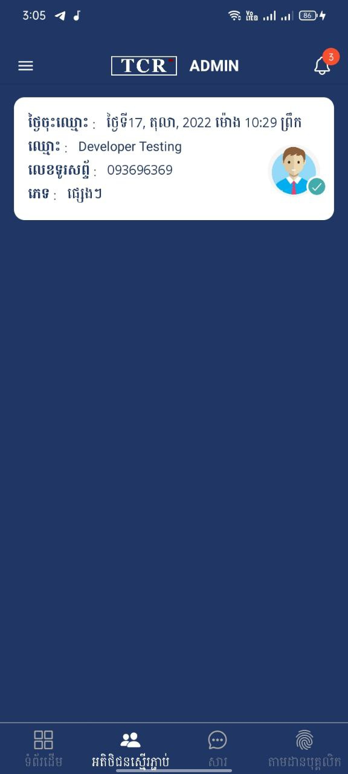
Admin App
Home Tap
Home Screen (Dash Board)
Customer
Chat
Staff

Slide 25
Special Function
User App
Booking Services (Real time booking depiction on map)
Maintenance Services
Transfers Money
Chat (real time)
Video and audio about car knowledge
Admin App
Booking Series(confirm, cancel, complete,)
Create Report for Car Maintenance (create, update, quotation, invoice)
Salary Report (daily, monthly, yearly)
Chat (real time)

Slide 26

2. Web (Admin Control Panel)

Slide 27
Budget
Package | Price | Description | Maintenance | Promote
Classic | $1.2K |  | Negotiate | Negotiate
Standard | $1.8K |  | Negotiate | Negotiate
Premium | $2.1K |  | Free | Free

Slide 28
Questions?

